Slide 1



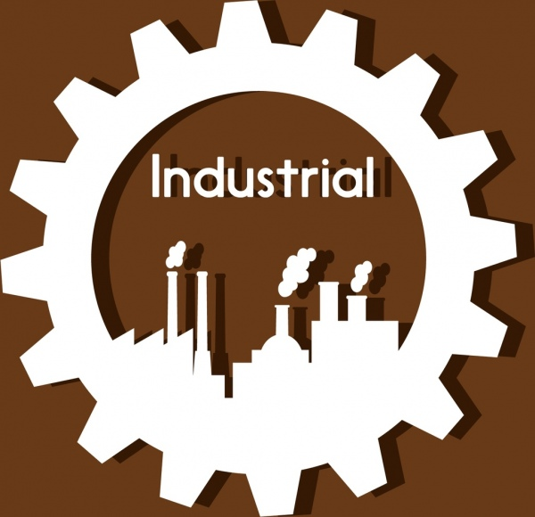
INDUSTRIAL USE CASES PREDICTIVE MODELLING ANALYTICS
Praniska N(927621bad037)
Prasana R(927621bad038)
Prasanth S(927621bad039)
III - AI&DS - VI SEM

Slide 2

PROBLEM STATEMENT
Thingworx for manufacturing predictive analytics

Slide 3
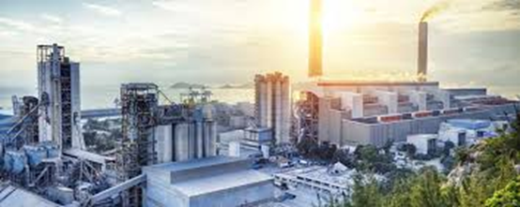
ABOUT INDUSTRY:
INDUSTRY NAME:Automobile Industry
EXPLANATION:
A large automotive manufacturing plant is using ThingWorx to optimize its production process. The plant produces various components such as engines, transmissions, and chassis for vehicles.
Objective: The plant aims to reduce downtime and improve overall equipment effectiveness (OEE) by implementing predictive maintenance for critical machinery.

Slide 4

SOLUTION EXPLANATION
A CNC machine used for milling engine components starts to exhibit abnormal vibration patterns during operation.
ThingWorx's predictive maintenance model detects this anomaly and predicts a high likelihood of bearing failure within the next 24 hours if left unaddressed.
An alert is generated, and maintenance personnel are notified immediately.

Slide 5
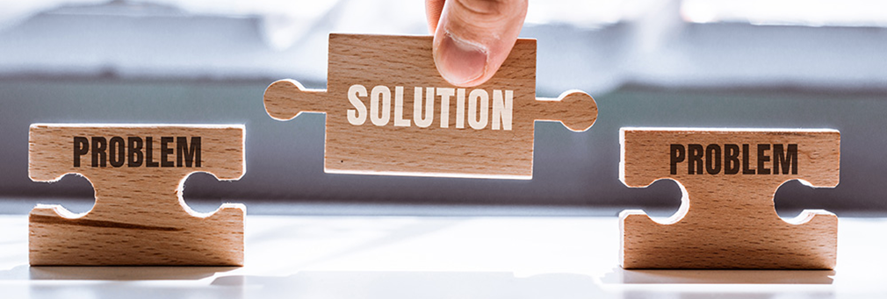
SOLUTION
Data Collection
Data Integration
Analytics Engine
Predictive Modeling
Alert Generation
Predictive actions

Slide 6
Data Collection:
ThingWorx enables the collection of data from various sources within the manufacturing plant, including sensors attached to machinery.
It can gather data on machine performance, temperature, vibration, energy consumption, and other relevant parameters.
Data Integration:
ThingWorx provides robust data integration capabilities, allowing the plant to aggregate data from disparate sources and formats into a unified platform.
It can integrate with existing systems such as enterprise resource planning (ERP) software, manufacturing execution systems (MES).

Slide 7
Analytics Engine:
ThingWorx offers powerful analytics capabilities for processing and analyzing the collected data in real-time.
It can perform descriptive, diagnostic, predictive, and prescriptive analytics to gain insights, identify patterns, and detect anomalies.
Predictive Modeling:
Using historical data, ThingWorx can build predictive models to forecast equipment failures and maintenance needs.
These models can leverage machine learning algorithms such as regression, classification, clustering, and time series analysis to predict.

Slide 8
Alert Generation:
ThingWorx can generate real-time alerts and notifications based on predefined thresholds or predictive models.
Alerts can be sent to maintenance personnel or operators via email, SMS.
Predictive Actions:
ThingWorx allows for the automation of predictive actions based on analysis results.
It can trigger maintenance work orders, schedule preventive maintenance tasks, adjust equipment settings.

Slide 9
BENEFITS
Data Acquisition and Aggregation
Automated Analytics with Machine Learning
Actionable Insights
Improved Efficiency and Reduced Costs
Customizable Models
Closed-Loop Feedback

Slide 10
INNOVATIONS
Integration with Advanced AI Techniques
Edge Computing and Analytics
Advanced Visualization and User Interface
Integration with Other IoT Platforms and Applications
Sustainability-focused Applications

Slide 11
CONCLUSION
ThingWorx offers a powerful platform for manufacturers to leverage the power of predictive analytics and gain valuable insights for optimizing operations, improving efficiency, optimize resource utilization, and achieving cost savings.
By staying at the forefront of innovation and addressing the evolving needs of the manufacturing industry, ThingWorx is poised to play a vital role in shaping the future of smart and sustainable manufacturing.

Slide 12

THANK YOU!

